Slide 1
Law & Order: Public Library Unit
A New Approach to Dealing with and Documenting Incidents in the Library
w/ James Dekens & Amanda Freeman
Notes:
AMANDA:
Welcome and thank you for joining us here today. Our hope for today's presentation is just as it was laid out in our session description: provide you with a very quick, very real snapshot of a practical move from a staff-focused, overly complex problem procedure and incident reporting process to a customer-focused Customer Experience Standard and simplified incident system.
We're going to move through our presentation and then complete a quick group activity to give you an idea of how this new system is used at BPL. For this activity, you're going to want to have your phones ready to do some voting. We have built in time for questions and answers. As well, because libraries are awesome, non-competitive places we're happy to share all of the stuff we've brought with us today—forms, documents, whatever. We've brought paper copies for you to look at and are happy to send things digitally as well after the presentation. We'll have our email addresses up on the final slide so you can reach us next week.
HAVE ON HAND:
Paper copies, Customer Experience Standards-AF
Paper copies, old Code of Conduct-AF
Paper copies, CSG-JD
Paper copies, IR Form-JD
Business cards-AF and JD
LAPTOP-AF and JD

Slide 2
Law & Order: Library Edition
Agenda
Review of the OLD: Code of Conduct and Problem Procedure Manual
Identify issues and pressure points
Review of the NEW: Customer Experience Standards and Customer Service Guidelines
New, updated Incident Reporting Process
The new form
Submission, tracking, debriefing
Green, Yellow, Red: group exercise
Results: what's changed and how has it improved?
Q&A
Notes:
AMANDA:
The agenda for today is pretty straight forward:
We'll review our OLD: Code of Conduct and Problem Procedure Manual
We'll identify issues and pressure points related to that system and explain why we decided to update it
We'll review of the NEW: Customer Experience Standards and Customer Service Guidelines as well as the NEW: updated Incident Reporting Process
We'll show you the new form
Go over the submission, tracking, debriefing process
And we'll explain what's changed and how the system has improved
We'll complete what we refer to as a 'Green, Yellow, Red' group activity
And finally, we'll have time for some questions and answers.

Slide 3
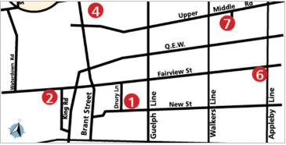
Law & Order: Library Edition
Who We Are
Total COB population: 205,000
Total # of BPL Branches: 6.5
Total # of BPL Staff: roughly 150 adult staff, 50 student staff
No security on site
Notes:
JAMES:
A brief introduction to our orgnaization

Slide 4
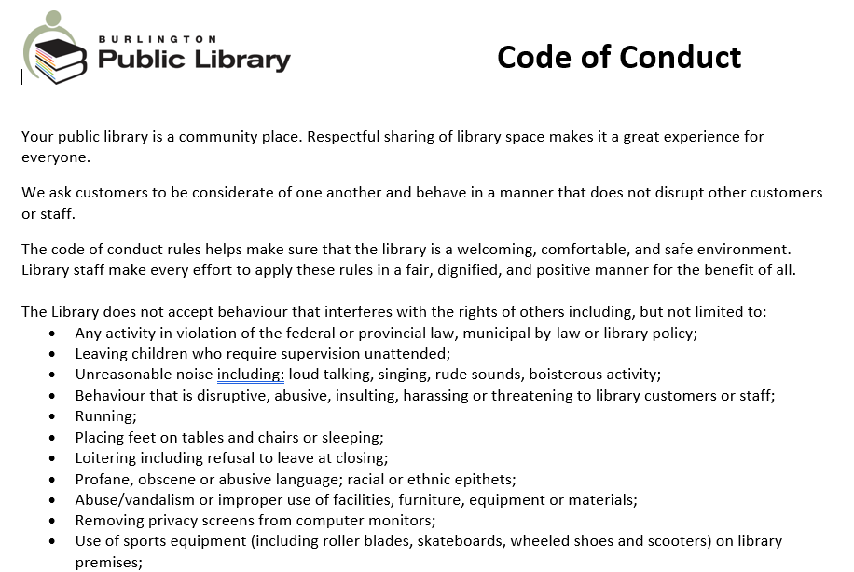
Code of Conduct + Problem Procedures = Incidents
Code of Conduct
Outdated list of unacceptable behaviours: "you can't do this, you can't do that...etc."
Staff vs. Customer focused
Set a "policing" atmosphere: staff looking for problems.
Notes:
AMANDA:
Almost all public spaces have some sort of Code of Conduct: no shirt, no shoes, no service, if you will. The intent of this Code is to develop and maintain a standard of conduct that is acceptable to the company, its customers and employees; and to give employees something to support their decision making.
What we found, however, is that the more specific the code of conduct, the more issues you'll begin to find within your walls.
BPL's former Code of Conduct was—for lack of a better phrase—a litany of very specific, unacceptable behavious: no hot food, no "rude noises", and no wheeled shoes, for Pete's sake! The Code focused on what you couldn't do, rather than what you could; what we would do as staff if you didn't follow our lengthy rules, rather than what we could do for you if you did!
The result? We were unintentionally setting staff up to look for problems and police the space.

Slide 5
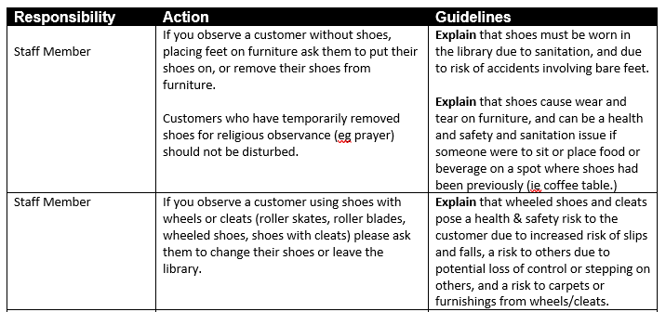
Code of Conduct + Problem Procedures = Incidents
Problem Procedure Manual (PPM)
A set of procedures to deal with our very specific list of unacceptable behaviours.
Overly complex and repetitive.
Inconsistent
Examples:
Food in the Library
Footwear
Strong Odour
Notes:
AMANDA:
The Problem Procedure Manual, or PPM, was the written binder of guidelines that staff consulted when there was an "infraction" of the Code of Conduct or when an emergency occurred.
The PPM was complex dealing with many imaginable scenario: the exception vs. the rule.
The PPM was often repetitive—for example, the procedure for "Food in the Library" often overlapped with the procedure for "Strong Odours".
The PPM was inconsistent both in the directives and in the way it was applied if the final step was overly harsh. Sometimes the PPM called for an Incident Report, and sometimes it was everyday implied but never said (to quote Jane Austen).
And because the end result was at times overly harsh (calling the police because someone refused to put their shoes on...) the PPM was thus also inconsistently applied.

Slide 6
Code of Conduct + Problem Procedures = Incidents
Incident Reports
In theory?
Written documentation of all serious public incidents
Tracking trends
Identifying repeat beahviour
Written documentation of injury
In practice?
Specific list of unacceptable behaviours > staff policing > needless documentation and escalation of minor or non-issues
Increased staff stress and anxiety
Varying outcomes
Privacy issues
Time suck
Notes:
AMANDA:
The purpose of incident reporting was and still is two fold:
1. To document all public incidents.
- So we have a record of serious, repeat behavior
- So we can identify trends – where are we having the most incidents? Is there a particular issue common amongst branches?
2. For legal reasons – if staff or customers are injured we need a paper trail.
We needed to change the process because the reality was far from the intent.
1. IR were stressful: a customer incident that involves yelling or an injury can be stressful to everyone, even those on the periphery. We didn't want documenting that incident to add to this stress level.
2. For privacy reasons: unless merited, customer privacy should be protected. Undue attention for a minor incident can be perceived as targeting. Furthermore, the Municipal Freedom of Information and Protection of Privacy Act (MFIPPA) spells out very clearly how we, as a public organization, need to protect the privacy of customers and staff. MFIPA gives members of the public the right to request information from public organizations, such as ourselves. Poorly documented incidents could cause issues down the road if an MFIPA request is made.
3. And finally, time: the previous version of the incident reporting process, in some areas, provided a bit too much information and allowed us to fill out more information than necessary. We wanted to document the incident – that it took place. Not the weather that day, what staff were wearing, how words made them feel, what they worried about while handling the incident, etc. Incident Reporting was leading to a lot more information than we needed.

Slide 7
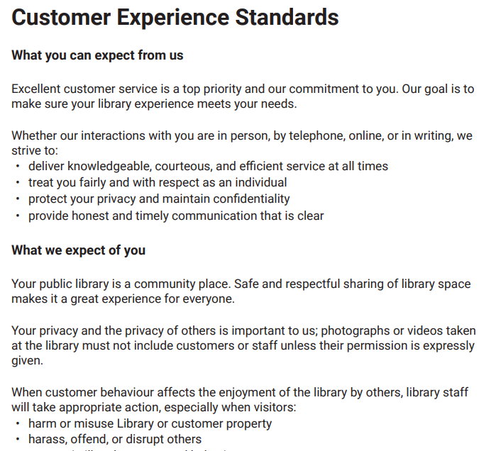
Overhauling the System: CSGs and IRs
Decision
From Code of Conduct to Customer Experience Standards
From Problem Procedures to Customer Support Guidelines
From Unnecessary Documentation to Incident Reporting
Notes:
To rectify, we first moved from a Code of Conduct to a Customer Experience Standard. The previous Code of Conduct, as mentioned, enabled staff to point out specific unacceptable actions and use them to tell customers what they could and could not do. With the Customer Experience Standards we moved towards conversations and an understanding of what’s expected. The CES are posted in all locations and are available on our website.
The Service Experience Management Team spent a good part of 2018 updating and condensing procedures into Customer Support Guidelines. The updated Guidelines, which replaced that PPM I referred to earlier, reflects our Voice and Values, aligned with our Safe Spaces or Crisis Prevention and Intervention techniques, and points to a more customer centred approach to our interactions. [hold up binder] While we won't get into specifics of how this changed today, we're happy to answer questions after about the new CSG and we'll have the binder on hand for you to flip through, if you like.
Finally, in January of 2019 we rolled out a new Incident Reporting process to reduce stress, time, and improve tracking of true infractions and emergencies.

Slide 8
Incident Reports
It was a dark and stormy night...
Notes:
JAMES:
The Incident report form prior to 2019 was a word document with fields for names, witnesses, descriptions, and so on. The form left a lot of white space for staff to fill in the details. And staff filled in the details.
What should have been a report about an incident instead came together as a descriptive short story form multiple perspectives. The forms included such details as "I was in the back room eating a snack..." or "I had just come back from helping a customer with the printer when..."
Each time an "incident" occurred – and from Amanda said earlier, you can gather this was often – the person in charge wrote up the incident report and gathered multiple staff perspectives. The process also called for these reports to be submitted within 24 hours, which often meant that multiple staff members would stay late compiling their side of the story for the person in charge before they left for the evening.
As well, when these incidents were posted, they were posted with staff and customer names for all BPL staff to see. The posted incidents were some of the most read documents on our intranet.

Slide 9
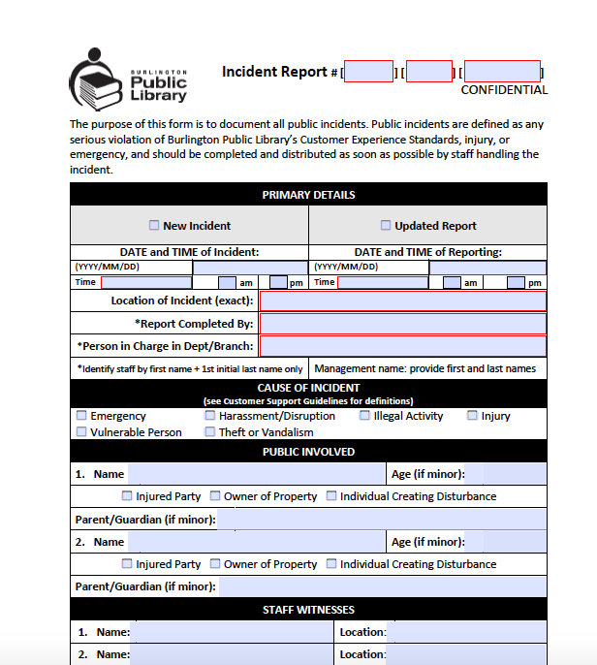
Incident Reporting: The New Form
Incident Reporting
Old: Multiple witnesses, multiple writeups
New: Just the facts, Ma'am.
Notes:
JAMES:
The New Incident Report form
Developed with a thought to save time, prevent stress, and overall make it easier to report and track incidents
- instead of large amounts of blank white space, we had constrained data fields
- instead of open definitions of incidents, we included specific categories
- instead of multiple staff perspectives, we required just one with a list of other staff who witnessed the event
- we challenged staff to ask themselves, is this an incident?

Slide 10
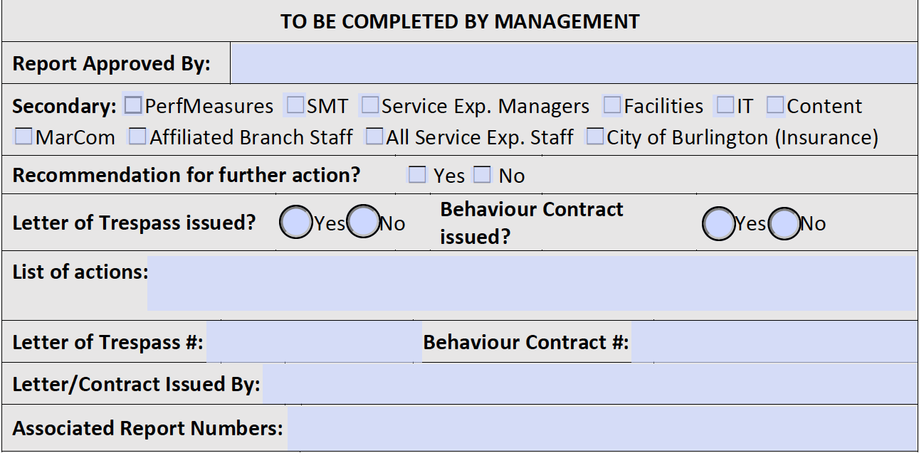
Submitting
Goal was to:
Reduce stress
Control information flow
Notes:
JAMES:
The Incident report form prior to 2019 was a word document with fields for names, witnesses, descriptions, and so on. The form left a lot of white space for staff to fill in the details. And staff filled in the details.
What should have been a report about an incident instead came together as a descriptive short story form multiple perspectives. The forms included such details as "I was in the back room eating a snack..." or "I had just come back from helping a customer with the printer when..."
Each time an "incident" occurred – and from Amanda said earlier, you can gather this was often – the person in charge wrote up the incident report and gathered multiple staff perspectives. The process also called for these reports to be submitted within 24 hours, which often meant that multiple staff members would stay late compiling their side of the story for the person in charge before they left for the evening.
As well, when these incidents were posted, they were posted with staff and customer names for all BPL staff to see. The posted incidents were some of the most read documents on our intranet.

Slide 11
Incident Reporting: The New Form
Tracking
Notes:
JAMES:

Slide 12
Incident Reporting: Training
Training
Sessions held at all locations.
Combined training session for all Non-service departments (Marketing, Content, Facilities, IT, etc)
Notes:
JAMES:
And now we approach everyone’s favourite part of any given project – rolling out the training sessions
- Training sessions were held for all staff (excluding pages)at every location
Along with an overview of why we were changing and what the new form would look like, we wanted to use the training sessions to get staff to use their judgement – is the situation they are dealing with actually an incident?
We chose a green yellow red approach to the new incident reports
Green – the situation is normal (for public libraries)
Yellow – keep an eye on the situation – it may escalate
Red – action and incident report required
Since this training we have used Green/Yellow/Red for other training sessions as well. Establishing it as a part of our lexicon- is this a green situation? Is this a yellow situation?
As an aside – our Customer Support Guidelines are in yellow binders. Generally, if you are consulting the guidelines you would be in a yellow situation
Our emergency procedures are in red binders and some branches have their person in charge/go to binders in green (another project for another time)

Slide 13
Staff Exercise: Green, Yellow, Red
Review the incident as a group
Indicate if you think the situation is:
Green: go, no incident report required
Yellow: use caution, and review the Customer Service Guidelines
Red: stop, file an incident report
If no incident report is required, indicate what (if any) follow up should be done with a Manager.
Notes:
JAMES
Note: Use your judgement—there are no right and wrong answers! When giving your answer, include your rationale.

Slide 14
Situation #1
A customer comes to the customer service desk to complain about a collections letter. They are talking loudly, waving their arms, and pointing. They are visibly upset as they argue the fines with staff.
GREEN, no incident
The customer asks to speak to "someone in charge..." The person in charge is called and the conversation escalates. The customer is now yelling and using expletives. The PIC tells they customer they must lower their voice in order to continue the conversation. A refusal to do so would mean they would have to leave the library.
YELLOW, consult the CSG
The customer throws the items in their hands and calls the PIC “f****ing stupid”. The PIC asks the customer to leave for the day.
RED, file an incident report
Notes:
JAMES:
First scenario: [READ]
There is no incident to report here. Angry (even rude) customers can be uncomfortable and stressful to deal with but there is no “major violation of our Customer Service Guidelines”.
There is no incident to report. Begin following CSGs for "Verbal Abuse/Harassment" and "Managing Challenging Customers“. LOD should debrief their TL or Manager later and use this as a customer service strategy at next branch meeting.
An incident report would be filed as it is now a serious violation of the CSG: ‘Harassment and verbal abuse’ after a warning has been issued, and ‘Staff feeling unsafe’. At BPL, when the situation moves from a warning to asking a customer to leave for the day, we consider that a major violation of our CSG.

Slide 15
Situation #2
A customer is yelling into her cellphone in the library entrance. Customers are giving staff looks as they walk by and a child witness begins crying. Staff on the Customer Service desk remind the customer they must lower their voice.
GREEN, no incident
The customer on the phone begins kicking the wall, putting a hole in the drywall. The LOD and the police are called.
RED, file an incident report
Notes:
JAMES:
Second scenario: [READ]
There is no incident to report here. Although it is a disturbance, there has been no “major violation of our CSG”.
An incident report would be filed as it is now a serious violation of the CSG and illegal activity: vandalism..

Slide 16
Situation #3
A customer has their feet up and is lying down in an armchair. They smell of alcohol. Staff ask the customer to remove their feet. The customer grumpily replies “leave me alone.” The staff member feels uneasy and reports the conversation to the LOD.
GREEN, no incident
The customer begins to loudly tell everyone in the area that the library is unfair and we are targeting him. The conversation is unwanted, and some customers leave the area as a result. A beer can falls out of their bag. Staff approach the customer and remind them that the behaviour is inappropriate and to please stop or they will be asked to leave the building. The customer elects to leave on their own.
YELLOW, consult the CSG
Notes:
JAMES:
Second scenario: [READ]
This is GREEN. There is no incident to report here.
This is YELLOW. There is still no incident to report, although we are now following the CSG for either "Customer under the influence" or "Managing Challenging Customers“. The LOD should debrief their TL or Manager later and use this as a customer service strategy at next branch meeting.

Slide 17
Siutation #4
A customer tells staff that they have been kicked out of their apartment and have nowhere to sleep that night. They have many bags with them. Just before closing, they ask staff for help finding shelter. Staff give the customer contact information for local area shelters and food banks. At closing, the customer is stalling and hesitant to leave the building. The LOD escorts the customer to the entrance and has difficulty disengaging from the very emotional conversation which continues past 9 pm. Finally, at 9:15, the LOD excuses themselves and directs the customer to the closest payphone.
GREEN, no incident
Notes:
JAMES:
Second scenario: [READ]
This is GREEN. There is no incident to report here.

Slide 18
Results: what's changed?
Anecdotal Improvements
Reduction of reported incidents
Staff are more comfortable handling elevated situations
Less policing and fewer "that guy from the incident report..."
Timely, relevant information sharing
Notes:
AMANDA:
We have seen a serious reduction in the frequency of incident reports. In 2019 there were 32 total incidents across 6.5 branches compared to 92 in 2018.
Fewer calls to Person In Charge phone (system in place for escalating situations). Staff are more empowered to handle incidents on the spot rather than referring because there isn't the gloom of "oh goodness, I’m going to need to follow this conversation with an incident report..."
Staff aren't looking for problems. The new process has created a more positive environment for all. Even better, customers (known to them or not) aren't being flagged when they walk in. Because incident reports aren't being shared as widely, there are more fresh starts for everyone involved.
When information does need to be shared, it's shared with those who NEED to know. With the built in debrief of all relevant incident reports and customer service strategies at branch meetings, staff get more of an opportunity to problem solve as a group and to come together with a team approach to challenging situations and customers. This translates into a healthier workplace as well as overall improved customer service.

Slide 19
Questions?
James P. Dekens
Manager, Neighbourhood Branches
dekensj@bpl.on.ca
Amanda Freeman
Manager, Alton Library
freemana@bpl.on.ca

